Slide 1
Delegates, Events, and LINQ

Slide 2
Objectives
Decrible about Delegate
Decrible about Event
Explain about Lambda and Query Expression
Explain about LINQ to Object
Explain about Generic Delegate Types: Func and Action
Demo about Func and Action delegates
Demo creating and using Delegates, Lambdas Expression, Query Expression and Events

Slide 3
Delegates in .NET

Slide 4
What is the Delegates?
The delegate is a reference type data type that defines the method signature
Delegate types are derived from the Delegate class in .NET. Delegate types are sealed and it is not possible to derive custom classes from Delegate
Using delegates, we can call any method, which is identified only at run-time
To associate a delegate with a particular method, the method must have the same return type and parameter type as that of the delegate
Represents a delegate, which is a data structure that refers to a static method or to a class instance and an instance method of that class

Slide 5
Delegate Class
The Delegate class is a built-in class defined to create delegates in C#
Constructors | Description
Delegate(object, string) | Calls a method referenced by the object of the class given as the parameter
Delegate(type, string) | Calls a static method of the class given as the parameter
Properties | Description
Method | Gets the method represented by the delegate
Target | Gets the class instance on which the current delegate invokes the instance method

Slide 6
Delegate Class
Methods | Description
Combine(Delegate, Delegate) | Concatenates the invocation lists of two delegates
CreateDelegate(Type, MethodInfo) | Creates a delegate of the specified type to represent the specified static method
DynamicInvoke(Object[]) | Dynamically invokes (late-bound) the method represented by the current delegate
GetInvocationList() | Returns the invocation list of the delegate
GetMethodImpl() | Gets the static method represented by the current delegate
RemoveImpl(Delegate) | Removes the invocation list of a delegate from the invocation list of another delegate
Clone() | Creates a shallow copy of the delegate.
MemberwiseClone() | Creates a shallow copy of the current Object.(Inherited from Object)
More Delegate Class: https://docs.microsoft.com/en-us/dotnet/api/system.delegate?view=net-5.0

Slide 7
Delegate Type
A delegate type maintains three important pieces of information:
The name of the method on which it makes calls
The arguments (if any) of this method
The return value (if any) of this method
Syntax
<access_modifier> delegate <return_type> DelegateName([parameters]);
For Example
public delegate int MyDelegate(int numOne, int numTwo);

Slide 8
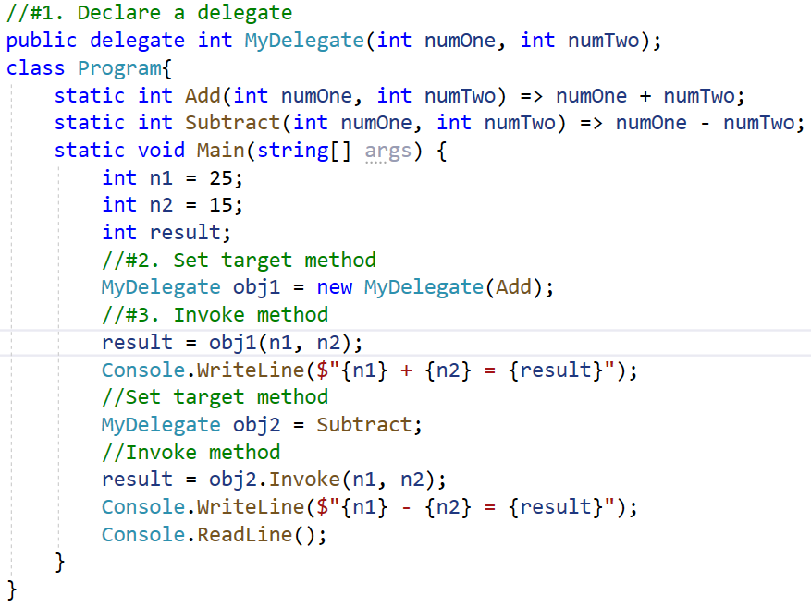

Instantiating Delegates

Slide 9
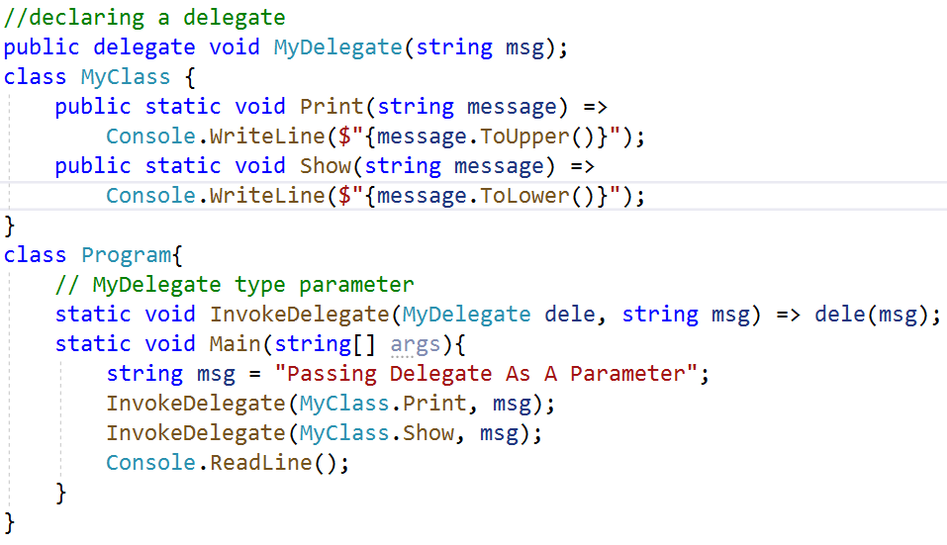

Passing Delegate as a Parameter

Slide 10
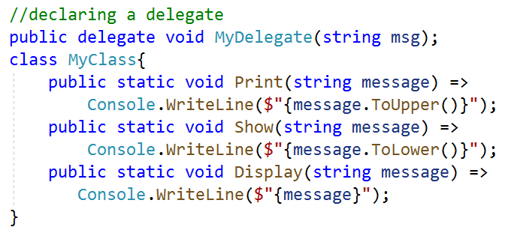
Multicast Delegate
The delegate can point to multiple methods. A delegate that points multiple methods is called a multicast delegate
The "+" or "+=" operator adds a function to the invocation list, and the "-" and "-=" operator removes it

Slide 11
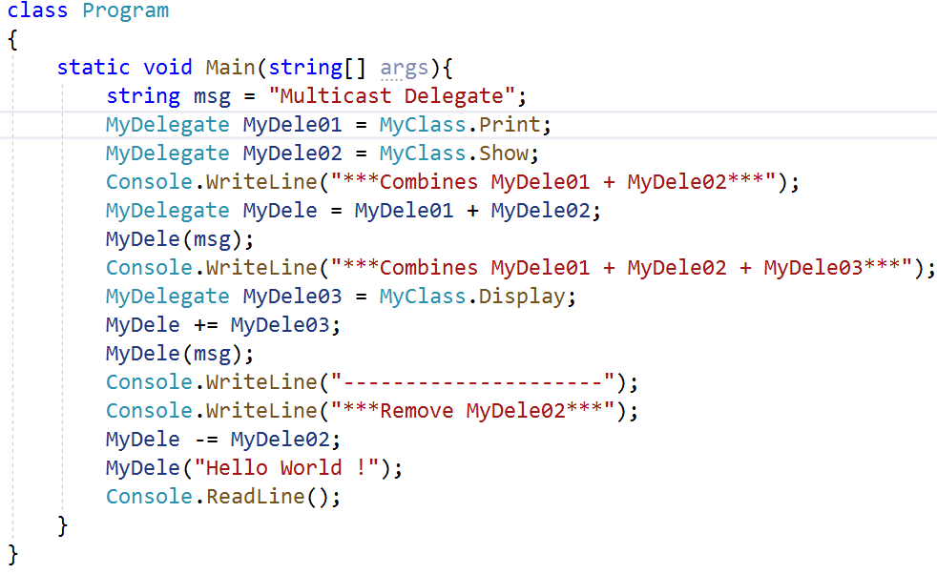
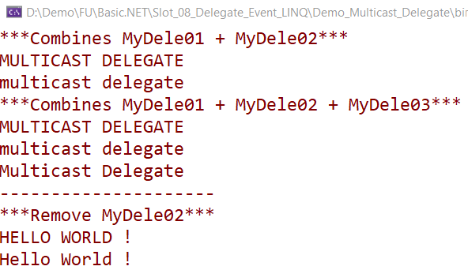
Multicast Delegate

Slide 12
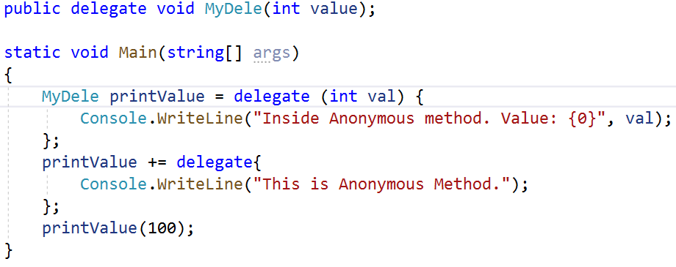

Anonymous Method
An anonymous method is a method without a name. Anonymous methods in C# can be defined using the delegate keyword and can be assigned to a variable of delegate type

Slide 13
Generic Delegate Types
C# includes built-in generic delegate types Func and Action, so that we don't need to define custom delegates manually in most cases
Func is a generic delegate included in the System namespace. It has zero or to 16 input parameters and one output parameter. The last parameter is considered as an output parameter
Func does not allow ref and out parameters. It an be used with an anonymous method or lambda expression.
An Action type delegate is the same as a Func delegate except that the Action delegate doesn't return a value(can be used with a method that has a void return type)
Func<T1, T2, TResult>(T1 arg1, T2 arg2) Delegate

Slide 14
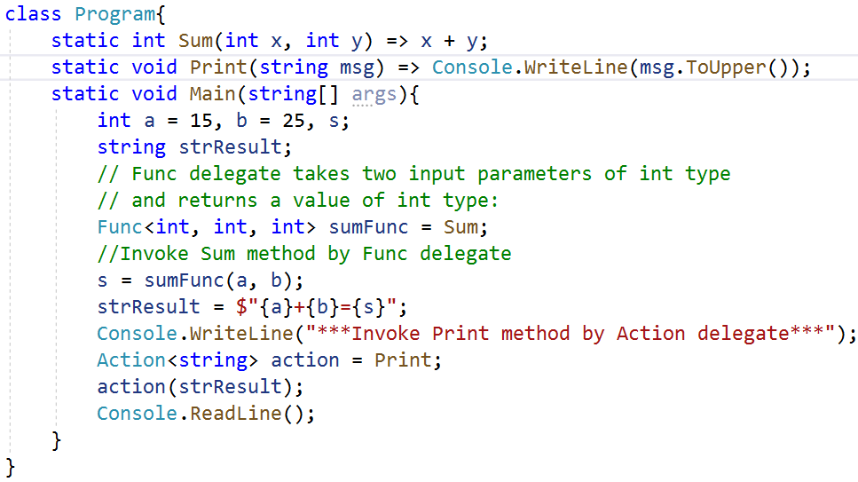

Generic Delegate Types

Slide 15
Events in .NET

Slide 16
Understanding C# Events
An event is a user-generated or system-generated action
An event is a notification sent by an object to signal the occurrence of an action. Events in .NET follow the observer design pattern
The events allow an object (source of the event) be able to notify other objects (subscribers) about the appeared event (a change having occurred)
The class who raises events is called Publisher, and the class who receives the notification is called Subscriber
There can be multiple subscribers of a single event. Typically, a publisher raises an event when some action occurred. The subscribers, who are interested in getting a notification when an action occurred, should register with an event and handle it

Slide 17
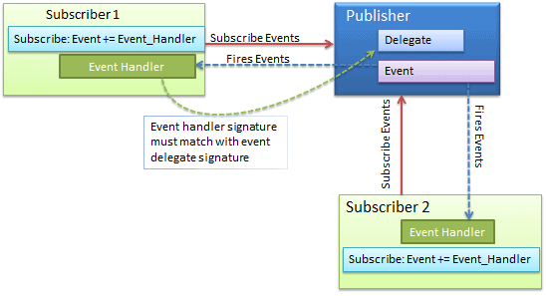
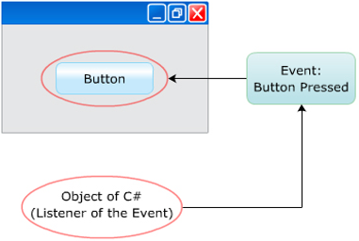
Understanding C# Events
Events can be used to perform customized actions that are not already supported by C#
Events are widely used in creating GUI based applications, where events such as, selecting an item from a list and closing a window are tracked

Slide 18
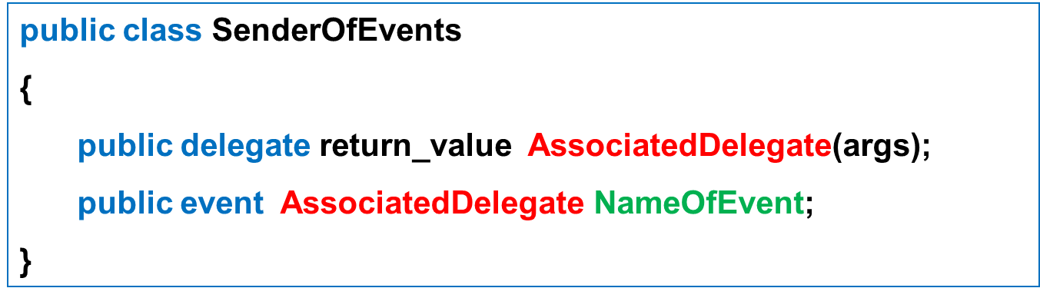
Defining C# Events
Using event keyword, the registration and un-registration methods as well as any necessary member variable delegate types are done automatically
Defining an event is a four-steps :
Define a delegate that contains the methods to be called when the event is fired
Declare the events (using the C# event keyword) in terms of the related delegate
Subscribe to listen and handle the event
Raise the event

Slide 19
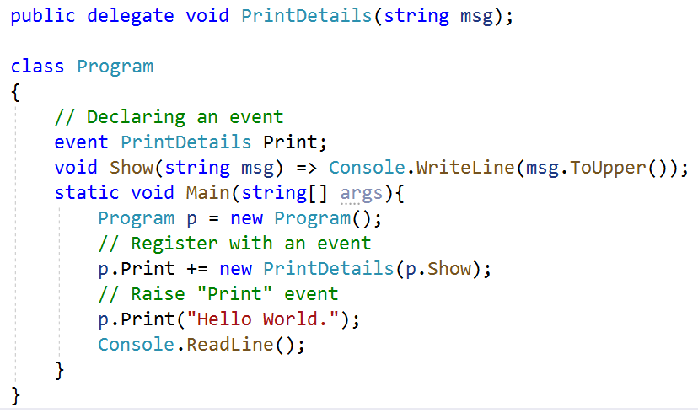
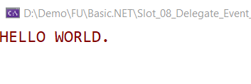
Implement Events
1
2
3
4

Slide 20
Language Integrated Query (LINQ)

Slide 21
Lambdas Expression
Lambda expressions in C# are used like anonymous functions, with the difference that in Lambda expressions we don’t need to specify the type of the value that we input thus making it more flexible to use
The ‘=>’ is the lambda operator which is used in all lambda expressions. The Lambda expression is divided into two parts, the left side is the input and the right is the expression
Syntax
parameter-list => expression or statements
parameter-list : is an explicitly typed or implicitly typed parameter list
=> : is the lambda operator

Slide 22
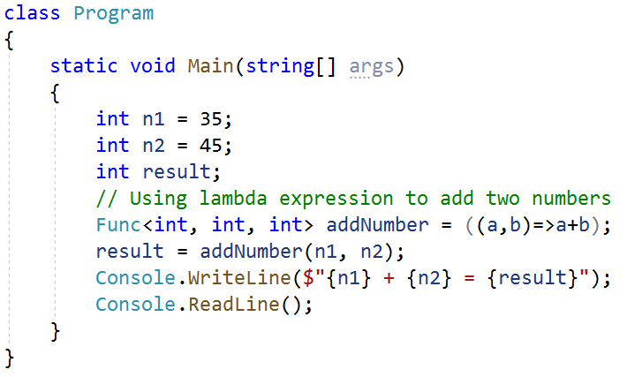

Lambdas Expression

Slide 23
Lambdas with Standard Query Operators
Lambda expressions can also be used with standard query operators
Operator | Description
Sum | Calculates sum of the elements in the expression
Count | Counts the number of elements in the expression
OrderBy | Sorts the elements in the expression
Contains | Determines if a given value is present in the expression

Slide 24
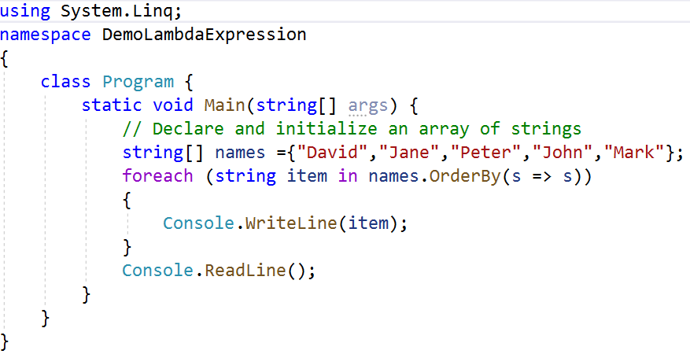
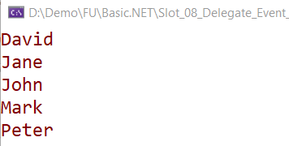
Lambdas with Standard Query Operators

Slide 25
Query Expressions
A query expression is a query expressed in query syntax
A query expression is a first-class language construct. It is just like any other expression and can be used in any context in which a C# expression is valid
A query expression consists of a set of clauses written in a declarative syntax similar to SQL or XQuery
A query expression is a query that is written in syntax using clauses such as from, select, where, group, order by, ascending, descending…These clauses are an inherent part of a LINQ query
LINQ simplifies working with data present in various formats in different data sources
A from clause must be used to start a query expression and a select or group clause must be used to end the query expression

Slide 26
Introduction of LINQ to Objects
Queries in LINQ to Objects return variables of type usually IEnumerable<T> only
LINQ to Objects offers a fresh approach to collections as earlier, it was vital to write long coding (foreach loops of much complexity) for retrieval of data from a collection which is now replaced by writing declarative code which clearly describes the desired data that is required to retrieve
There are also many advantages of LINQ to Objects over traditional foreach loops like more readability, powerful filtering, capability of grouping, enhanced ordering with minimal application coding
LINQ queries are also more compact in nature and are portable to any other data sources without any modification or with just a little modification

Slide 27
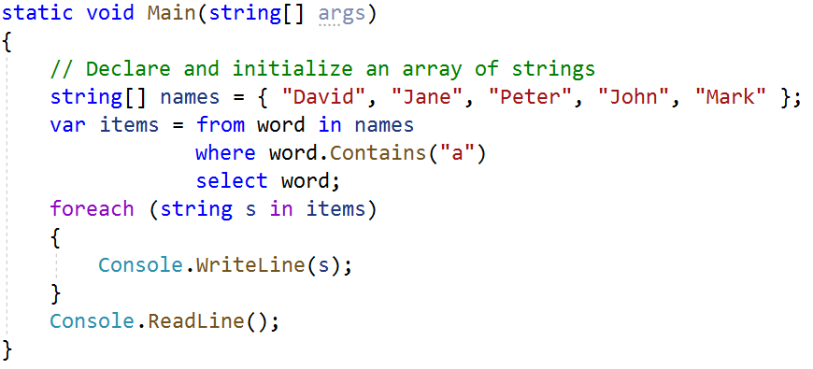
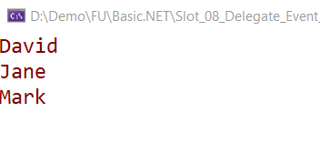
LINQ to Objects with Query Expressions

Slide 28
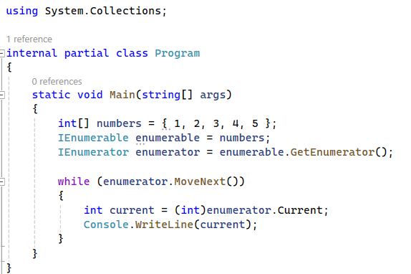
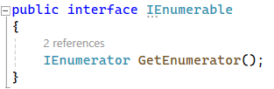
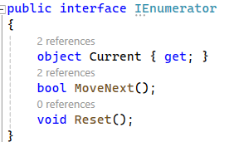
IEnumerable – IEnumerator in details
IEnumerable: Represents a collection that can be enumerated. IEnumerable is an interface that exposes a method for iterating over a collection.
IEnumerator: Provides a mechanism for iterating over the elements of a collection. IEnumerator is an interface that represents an iterator over a collection.

Slide 29
IQueryable in .NET
IQueryable is an interface in .NET that represents a queryable data source, allowing for deferred execution of queries.
IQueryable enables building dynamic queries at runtime and executing them against various data sources, such as databases or in-memory collections.
IQueryable<T> is a generic interface that inherits from IEnumerable<T> and represents a queryable data source of type T.
IQueryable<T> provides methods for querying data, such as Where, Select, OrderBy, Skip, Take, etc.
Example: IQueryable<Product> query = dbContext.Products .Where(p => p.Category == "Electronics").OrderBy(p => p.Price) .Skip(5).Take(10);

Slide 30
IQueryable in .NET
IQueryable<Product> query = dbContext.Products
.Where(p => p.Category == "Electronics")
.OrderBy(p => p.Price)
.Skip(5)
.Take(10);
This example creates an IQueryable object representing a query to retrieve products from a database.
The query is composed of multiple operations like filtering by category, ordering by price, skipping the first 5 records, and taking the next 10 records.
The actual execution of the query is deferred until enumeration.

Slide 31
Benefits of Using IQueryable
Dynamic Queries: Allows for building dynamic queries at runtime based on user input or conditions.
Optimized Query Execution: Enables the query provider to translate LINQ queries into efficient SQL queries for databases.
Code Reusability: Queries can be defined as IQueryable expressions and reused across multiple parts of the application.

Slide 32
LINQ Exercises
#1.
int[] n1 = new int[10] { 0, 1, 2, 3, 4, 5, 6, 7, 8, 9 };
// nQuery is an IEnumerable<int>
var nQuery = from tmp in n1
where (tmp % 2) == 0
select tmp ;
#2.
int[] n1 = { 1, 3, -2, -4, -7, -3, -8, 12, 19, 6, 9, 10, 14 };
var nQuery = from tmp in n1
where tmp> 0
where tmp< 12
select tmp;
#3.
List<string> animals = new List<string> { "zebra", "elephant", "cat", "dog", "rhino", "bat" };
var selectedAnimals = animals.Where(s => s.Length >= 5).Select(x => x.ToUpper());

Slide 33
LINQ Exercises
#4.
List<int> numbers = new List<int> { 6, 0, 999, 11, 443, 6, 1, 24, 54 };
var top5 = numbers.OrderByDescending(x => x).Take(5);
#5.
class Pet
{
public string Name { get; set; }
public int Age { get; set; }
}
public static void OrderByEx1()
{
Pet[] pets = { new Pet { Name="Barley", Age=8 },
new Pet { Name="Boots", Age=4 },
new Pet { Name="Whiskers", Age=1 } };
IEnumerable<Pet> query = pets.OrderBy(pet => pet.Age);
}

Slide 34
LINQ Exercises
#6.
class PetOwner {
public string Name { get; set; }
public List<string> Pets { get; set; }
}
public static void SelectManyEx3()
{
PetOwner[] petOwners = { new PetOwner { Name="Higa", Pets = new List<string>{ "Scruffy", "Sam" } },
new PetOwner { Name="Ashkenazi", Pets = new List<string>{ "Walker", "Sugar" } },
new PetOwner { Name="Price", Pets = new List<string>{ "Scratches", "Diesel" } },
new PetOwner { Name="Hines", Pets = new List<string>{ "Dusty" } } };
var query = petOwners.SelectMany(petOwner => petOwner.Pets, (petOwner, petName) => new { petOwner, petName }).Where(ownerAndPet => ownerAndPet.petName.StartsWith("S")) .Select(ownerAndPet =>
new {
Owner = ownerAndPet.petOwner.Name,
Pet = ownerAndPet.petName
})
}

Slide 35
Summary
Concepts were introduced:
Decrible about Delegate
Decrible about Event
Explain about Lambda and Query Expression
Explain about LINQ to Object
Explain about Generic Delegate Types: Func and Action
Demo about Func and Action delegates
Demo creating and using Delegates, Lambdas Expression, Query Expression and Events

